Slide 1
Proposal for New LPV Focus Area – Vegetation Indices
Tomoaki Miura – University of Hawaii at Manoa
Marco Vargas – NOAA Center for Satellite Applications and Research
CEOS LPV Working Group Meeting at Prague, May 10-11, 2016

Slide 2
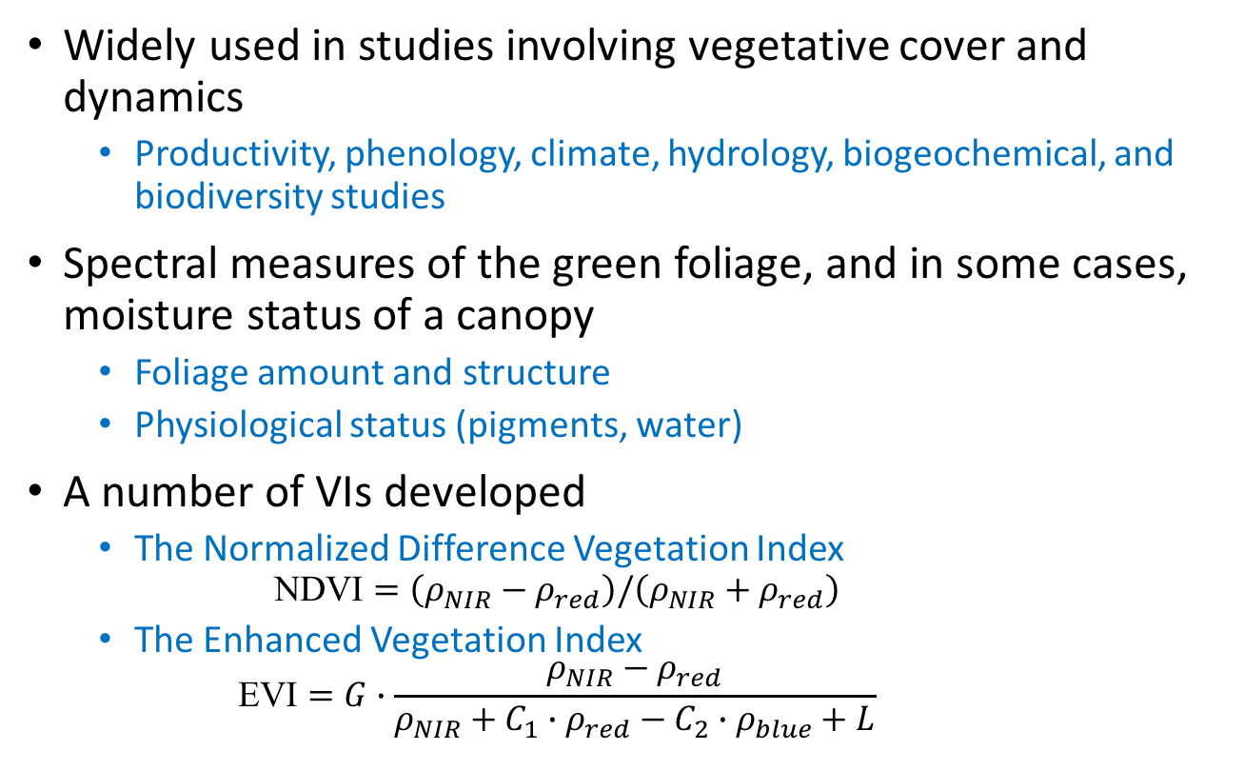
Vegetation Indices

Slide 3
Applications of Vegetation Indices (VIs)
Vegetation-climate studies – Direct use of VIs
Increased plant growth in the northern high latitudes (Myneni et al. 1997)
Dry-season greening of Amazon forests (Saleska et al. 2007; Morton et al. 2014; Saleska et al. 2016)
Ecosystem resilience (Ponce Campos et al. 2013)
Terrestrial ecosystem sensitivity (Seddon et al. 2016)
Phenology
Start of growing season (Zhang et al 2003; White et al 2009)

Slide 4
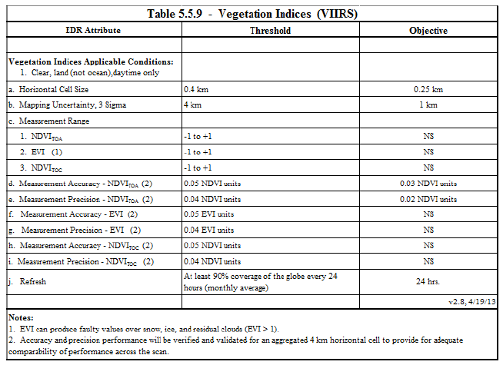
JPSS Vegetation Index EDR Requirements Summary
Source: Level 1 Requirements Supplement – Final Version: 2.10 June 25, 2014

Slide 5
WMO Requirements for Global NDVI Products
G=goal; B=breakthrough; T=threshold
Application | Uncertainty (%) |  |  | Spatial Resolution (km) |  |  | Temporal Resolution
 | G | B | T | G | B | T | G | B | T
Global Weather Prediction | 5 | 10 | 20 | 2 | 10 | 50 | 24 h | 5 d | 10 d
High Resolution Weather Prediction | 5 | 10 | 20 | 1 | 5 | 40 | 12 h | 24 h | 2 d
Hydrology | 1 | 2.7 | 20 | 0.01 | 0.292 | 250 | 24 h | 3 d | 30 d
Agricultural Meteorology | 5 | 7 | 10 | 0.03 | 2.2 | 10 | 24 h | 46 h | 7 d
Nowcasting | 5 | 10 | 20 | 1 | 5 | 40 | 12 h | 24 h | 7 d
(http://www.wmo-sat.info/oscar/variables/view/107)

Slide 6
Validation Activities
Product cross-/inter-comparison (e.g., VEGETATION vs. MODIS, MODIS vs. VIIRS, MODIS vs. ASTER)
In situ tower networks
AERONET-based reflectance
Baseline surface radiation network
FLUXNET
Phenology networks (e.g., PhenoCam)
In situ reflectance measurements

Slide 7
Proposed/Discussion Items
Global validation protocols
Sampling for both in situ data & inter-comparison
Coordination with the Phenology subgroup

